Slide 1
Reporting fossil fuel subsidies in the context of the SDG 12.c.1: the case of Italy
Chiara Antonelli
Gionata Castaldi
Ministry of Economy and Finance
SDG Indicator 12.c.1 training – May 23, 2022
The views expressed in the presentation are those of the authors and do not necessarily reflect those of the MEF

Slide 2
Enhancing Transparency on FFS: reporting tools
The Catalogue of EHS and EFS in Italy
The G20 Peer Review on FFS: Italy and Indonesia
The pilot test on the indicator SDG 12.c.1
Looking to specific subsidies as potential case studies

Slide 3
The goal of the Catalogue Definition of a subsidy
The Catalogue is a technical tool at
the service of
Parliament, Government and the scientific community; it attempts to report all the information made available and the possible and legitimate various evaluations of experts and public bodies. The final evaluations expressed in the Catalogue remain the responsibility of the Ministry for Ecological Transition.
The definition of a subsidy, as provided by the law mandating the Catalogue, is wide, including incentives, benefits, tax exemptions and credits concerning taxes related to environmental protection.

Slide 4
Definition of a subsidy
First level classification
Second level classification (case studies)
Who covers the subsidy and how
Direct transfers of public resources to economic agents
Public bodies (public expenditure)
Direct subsidies
Potential transfer of public resources to economic agents
Direct transfers of resources withdrawn through tariffs on public services
Public service users (e.g. electricity bills)
Tax expenditures (any form of exemption, exclusion, reduction of tax base or rate as a consequence of current regulations):
Selective exemptions of specific categories of beneficiaries deviating from general principles and obligations, as provided by current regulations (e.g., exemption from tax rates or duties)
tax rate reductions (implementation of a reduced tax rate);
tax base deduction (e.g., deduction from total revenue, reliefs, e.g. royalties oil & gas);
reduction of taxation (deduction, tax credit, substitute taxes);
reimbursement of taxes;
tax deferrals;
favourable tax regimes (tax regimes alternative to ordinary ones);
implementation of a flat-rate criteria to determine the tax base and that can potentially bring to foregone revenue (e.g. fringe benefit for company cars).
Indirect subsidies
Public bodies (foregone revenue)
Implicit subsidies arising from different fiscal treatment of comparable and equivalent activities or products (excise duties on fuels used for electricity production vs industrial uses, different tax treatment among diesel/gasoline, underpricing of natural resources, etc.)
Public bodies (foregone revenue)
Indirect subsidies
Tariff benefits or exemptions to specific categories of consumers (cross-subsidies) (e.g. bonus to poor families, etc.)
Specific public service users (treatment inequality that determine environmental damage)
Public bodies (foregone revenue), citizens (burden of environmental costs from polluters to collectivity)
Out of Scope
Implicit financial transfers resulting from a lack of full cost pricing (external costs)
Source: The Italian Catalogue on EHS and EFS – 4th Edition.
4

Slide 5
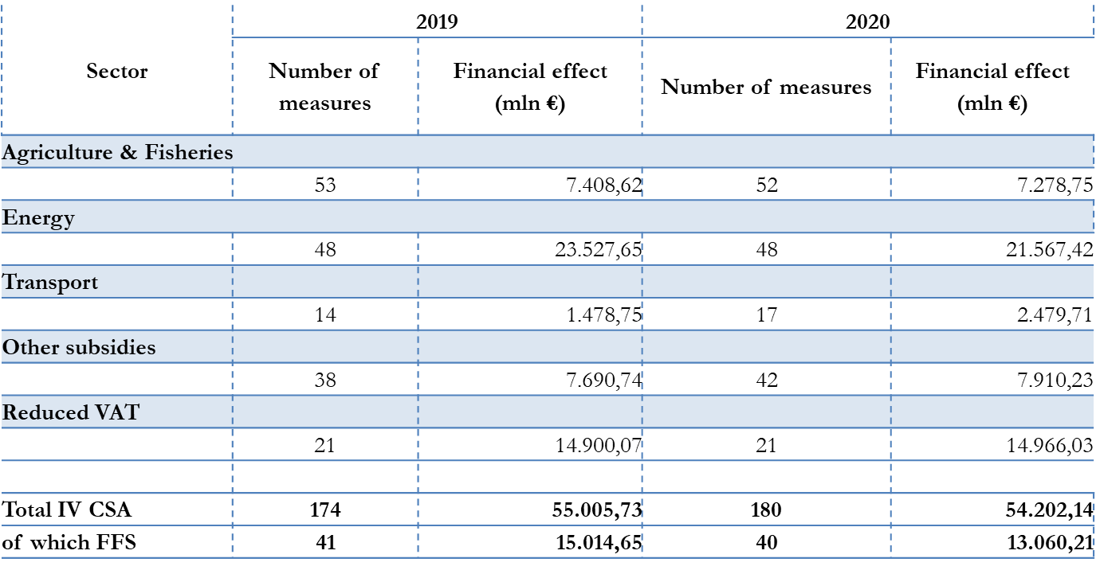
The Catalogue at its Fourth Edition: Main Results
Source: The Italian Catalogue on EHS and EFS – 4th Edition

Slide 6
The G20 Peer Review on FFS
Different elements:
Experts from 9 countries: Indonesia - China - NZel - Chile - Argentina - Canada - Germany - France - Netherlands + IGOs + Think Tanks; the largest team to date
Argentina and Canada, former Presidencies of the G20 and G7, entered the Peer Review exercise. Netherlands joined and published.
39 FFSs reported by Italy divided by level of reformability.
Indonesia and Italy decided not to focus on the term “inefficient”
The involvement of at least three communities is crucial: energy and industry, economy and finance, environment and climate.

Slide 7
OECD Fossil Fuels Support Inventory Database
Two main sources for the identification and evaluation of the financial effect of FFS
Italian Ministry of Ecological Transition
Identification of FFS (via the Catalogue)
Financial evaluation of non fiscal subsidies (e.g., Royalty- Free Thresholds)
Italian Ministry of Economy and Finance
Financial evaluation of fiscal subsidies via:
Annual tables on fiscal expenditures
ad hoc computations (VAT rates, diesel differential, ETS)

Slide 8
Road to the Reporting Template
November 2020: the OECD proposed to implement data collection for SDG 12.c.1 leveraging on the “Fossil Fuel Support Inventory Database”. To this end, Member countries were invited to join the Informal Task Team on Measuring Fossil Fuel Subsidies.
June 2021: ITT-FFS asked countries to participate to a pilot test on checking the reporting template with data coming from the Inventory.
Opportunity: Data in three different database (Catalogue, Inventory and SDG 12.c.1) fully consistent.

Slide 9
The reporting template: elements and characteristics
Template to identify and report on subsidy measures, according to the Methodology of SDG Indicator 12.c.1.
Subsidy measures listed per row and classified according to the different categories.
Name of the subsidy, description, sources, start and end date, and the values of the subsidy for the different years entered manually.
Inclusion of historical data from 2015 as to identify trends, given that the value of fossil fuel subsidies can be volatile depending on different factors, such as the price of oil in international markets.
Only actual values reported - estimates or projections for a given year excluded.
Values reported in local currency in nominal values and using millions as units.
Main elements included:
Description of subsidy
Level
Sources
Scope of data reported
Current status
Start date
End date
Typology, Category
Typology, Sub-category
Fuel type
Fuel sub-type
Recipients
Stage of support
Incidence
Comments
Currency
Financial value (2015-2020)
9

Slide 10
A hands-on example: the template layout (overview)
Name of subsidy | Level | Current status | Start date | End date | Typology, Category | Typology, Sub- category | Fuel type | Recipients | Stage of support | Incidence | 2015 | 2016 | 2017 | 2018 | 2019 | 2020
Energy Tax Breaks for Agriculture | Central/ Federal | Ongoing | 01- 01- 1993 | -- | Tax expenditures | TAX EXPENDITURES - Tax breaks and revenue foregone | Petroleum products | Consumption | END | Direct Consumption | 843,22 | 864,8 | 913 | 938,7 | 935,4 | 942,7
Tax Relief for Trucking Companies | Central/ Federal | Ongoing | 01- 01- 2001 | -- | Tax expenditures | TAX EXPENDITURES - Tax breaks and revenue foregone | Petroleum products | Consumption | END | Direct Consumption | 1292,3 | 1264,4 | 1587,5 | 1319,9 | 1361,8 | 1293, 8
Royalty-Free Threshholds | Central/ Federal | Ongoing | 01- 01- 1997 | -- | Tax expenditures | TAX EXPENDITURES - Under-pricing of non-energy government- owned natural resources or land | Petroleum products | Production | EXTRAC T | Land and natural resources | 85,6 | 52 | 52 | 52 | 52 | 152,8
Fuel Tax Exemption on the Electricity Used by Households with Installed Capacity up to 3kW and Monthly Consumption up to 150kWh | Central/ Federal | Ongoing | 01- 01- 2007 | -- | Tax expenditures | TAX EXPENDITURES - Tax breaks and revenue foregone | Electricity | Consumption | END | Direct Consumption | 634,08 | 586,4 | 586,7 | 591,8 | 578,6 | 582,2
Differential Excise Tax Treatment for Diesel Fuel | Central/ Federal | Ongoing | 01- 01- 1995 | -- | Tax expenditures | TAX EXPENDITURES - Tax breaks and revenue foregone | Petroleum products | Consumption | END | Direct Consumption | 3034,8 | 3069,3 | 3034,2 | 3183,1 | 3144,9 | 2610, 6
10

Slide 11
Case study: Diesel differential – implicit subsidy
Sector: | Energy
Subsidy name | Differential Excise Tax Treatment for Diesel Fuel
Duration: | 1993 - ongoing
Description: | Diesel fuel benefits from a reduction of 23% of the excise tax vis-à-vis motor gasoline. This measure effectively subsidises the consumption of diesel fuel at the detriment of motor gasoline.
Type of subsidy: | Indirect subsidy - revenue foregone
Rate: | Gasoline rate: 728,4 €/1000 lts |  |  | Diesel rate: 617,4 €/1000 lts
Level of reformability: | National
Motivation: | The difference in the fiscal treatment between diesel and gasoline is an implicit subsidy given the unequal treatment with respect to equivalent activities or products. In Italy the excise duty applied to diesel is considerably lower than that of gasoline and this is not justified. Italy has a differential for diesel of approximately 85%, while the externalities associated with diesel are higher than with petrol and this would justify a higher taxation.
Financial effect (mln €) | 2015 | 2016 | 2017 | 2018 | 2019 | 2020
 | 3034,85 | 3069,36 | 3034,24 | 3183,15 | 3144,93 | 2610,68
11

Slide 12
Case study: ETS free allowances and the benchmark
Sector: | Energy
Subsidy name | ETS quotes distributions
Duration: | 2005 - ongoing
Description: | As a result of transitory norms for the implementation of measures necessary to fulfil the Paris Agreement, some emission quotas under the ETS are distributed free of charge.
Type of subsidy: | Induced transfers - Price support, including through market regulation
Rate: | Ordinary: 15 €/tCO2 |  |  | Reduced: 0 €/tCO2
Level of reformability: | EU level
Motivation | The allocation of emission allowances free of charge constitutes a form of subsidy for industries subject to the ETS, which is harmful to the fight against climate change and in contrast with the objectives of reducing emissions on a global scale deriving from Paris Agreement.
Financial effect (mln €) | 2015 | 2016 | 2017 | 2018 | 2019 | 2020
 | 654 | 370.83 | 394.63 | 980 | n.a. | n.a.
12

Slide 13
Case study: Classifying and relating VAT to FFS
Sector: | Reduced VAT
Subsidy name | VAT Reduction on Electricity for Domestic Use
Duration: | 1972 - ongoing
Description: | This measure grants a VAT of 10% instead of 22% to the domestic consumption of electricity.
Type of subsidy: | Reduced Rate - Indirect subsidy |  |  | NOT a tax expenditure
Rate: | Ordinary: 24,32 €/tCO2 |  |  |  | Reduced: 0 €/tCO2
Level of reformability: | National
Motivation | Reduced VAT rate on electricity, gas and other fossil fuels does not encourage an efficient use of polluting energy sources. It is a fossil fuel subsidy for the share of electricity production related to fossil fuels.
Financial effect (mln €) | 2015 | 2016 | 2017 |  | 2018 | 2019 | 2020
 | 1429,92 | 1606,40 | 1663,79 |  | 1765,14 | 1779,98 | 1944,06
13

Slide 14
Case study: Case-study: Classifying Fringe Benefit
Sector: | Transport
Subsidy name | Tax concessions on fringe benefits in favor of the worker who uses the company car in a mixed manner
Duration: | 2010 - ongoing
Description: | Income tax applied for a range spanning from 25% to 60% of the amount corresponding to a conventional mileage of 15,000 kilometers multiplied by a kilometer operating cost in relation to the period of the year of use.
Type of subsidy: | Flat Rate criterion that brings to a different tax base - Indirect subsidy
Rate: | Ordinary: n.a. |  |  | Reduced: n.a.
Level of reformability: | National
Motivation | Since the fringe benefit tax treatment is a flat-rate type, if the distance actually traveled each year in a personal capacity is greater than the amount of km covered by the percentage threshold, the additional benefits for the employee are not taxed (subsidy).
Financial effect (mln €) | 2015 | 2016 | 2017 | 2018 | 2019 | 2020
 | n.a. | n.a. | n.a. | n.a. | n.a. | n.a.
14

Slide 15
Defining the tax benchmark
Name of subsidy (tax expenditure) | Type of benchmark used | Value of benchmar k used | Value of tax for the measure | Year
ETS quotes distributions | Conceptual approach | 15 €/tCO2 | 0 €/tCO2 | 20,1 8
 | Conceptual approach - Setting the benchmark on the structural features of the tax system | Diesel: 797,80 €/1000 lt* € 728.40 / 1000 liters) | Diesel: 617,40 €/1000 lt | 2021
Differential Excise Tax Treatment for Diesel Fuel
VAT Reduction on Electricity for Domestic Use | Conceptual approach | 22% | 10% | 2021
VAT Reduction on Electricity, Natural Gas and LPG used in Some Manufacturing, Agricultural and Extractive Activities | Conceptual approach | 22% | 10% | 2021
VAT Reduction on Oil Products Used in Electricity Production and Some Manufacturing and Agricultural Activities | Conceptual approach |  |  | 2021
 |  | 22% | 10%
VAT Reduction on Oil Products Used by Agricultural Enterprises and Fishing Enterprises Operating in Internal Waters | Conceptual approach |  |  | 2021
 |  | 22% | 10%
VAT Reduction on Natural Gas and LPG Used for for Cooking and Water-Heating Purposes | Conceptual approach | 22% | 10% | 2021
VAT exemption on taxi used for urban transport | Conceptual approach | n.a. | 0% | 2021
15

